Slide 1
Hostel Management System
By Technogeeks (HV005)

Slide 2
Problem Statement
Currently, the whole hostel admission process and all other hostel administration is done on paper manually.
We have developed a platform that automate the management of hostel activities, including registering and applying, room allocation, check-in, check-out, attendance, different applications, and inventory management. Administrators can allocate the rooms to eligible candidates based on their merit rank and home town distance.
An automated Hostel Management System would significantly improve efficiency, accuracy, and user experience for both students and administrators. It would reduce manual effort, provide real-time updates, enable data-driven decisions, and enhance communication and resource allocation.

Slide 3



Types of user:
Hosteller
Warden
Admin

Slide 4
Users
Admin User:
Allocate rooms
Check Rooms occupancy
Access student database to add or remove students

Slide 5
Users
Student User:
See or update Student information
Apply for leave
File complains

Slide 6
Users
Warden User:
Mark attendance
Check In/Out of students
Inventory management

Slide 7
Objective
The main objective of the project work are that:
Students won’t have to apply for hostel manually.
It will reduce manual work of warden as well as admin.
Saves time, improve efficiency and accuracy, smooth running of the program
Error free, effective and easy keeping database of the students

Slide 8
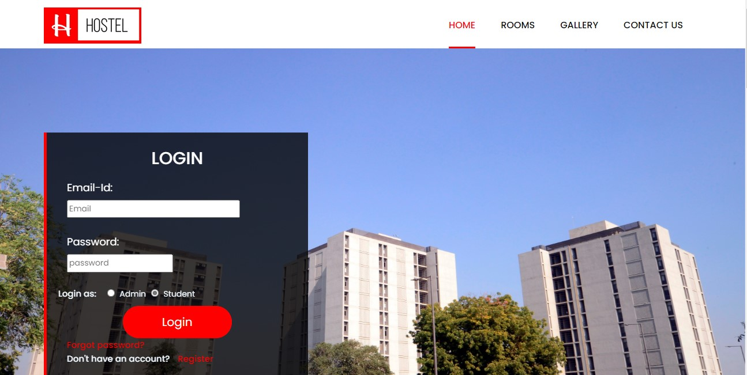
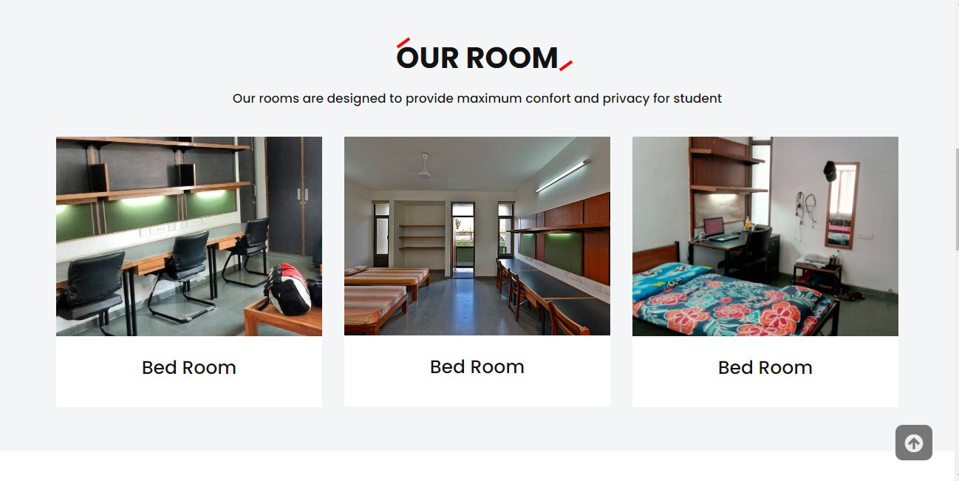
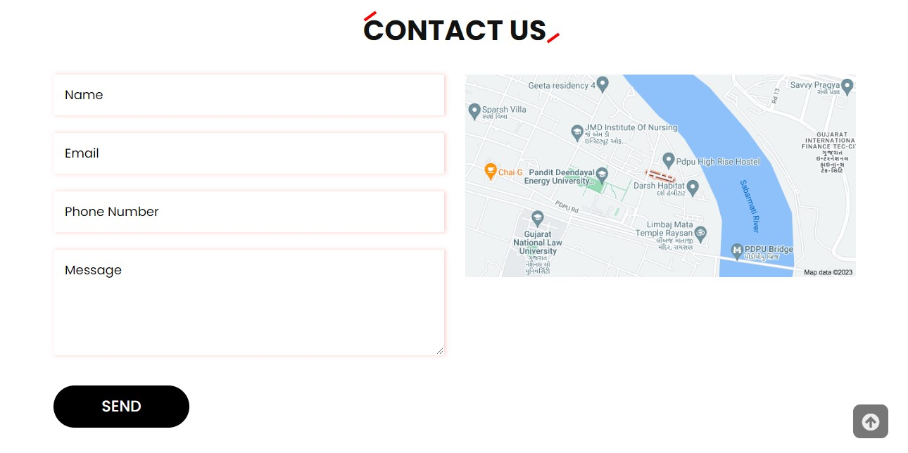
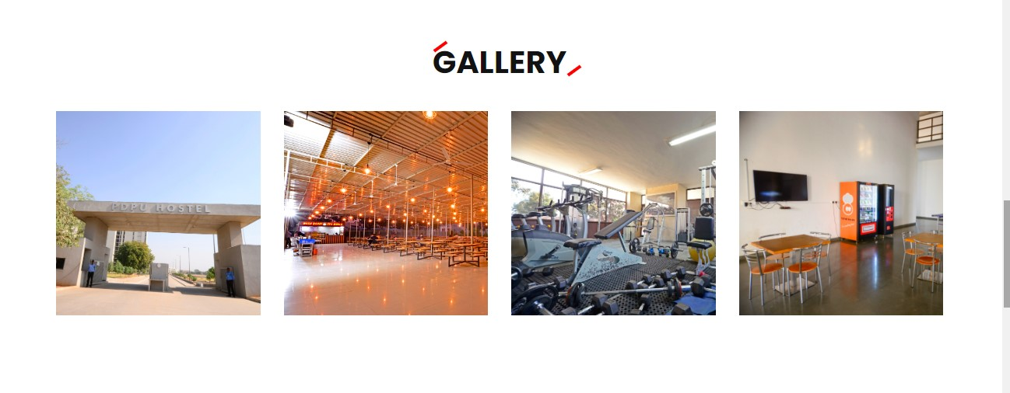
Home page

Slide 9
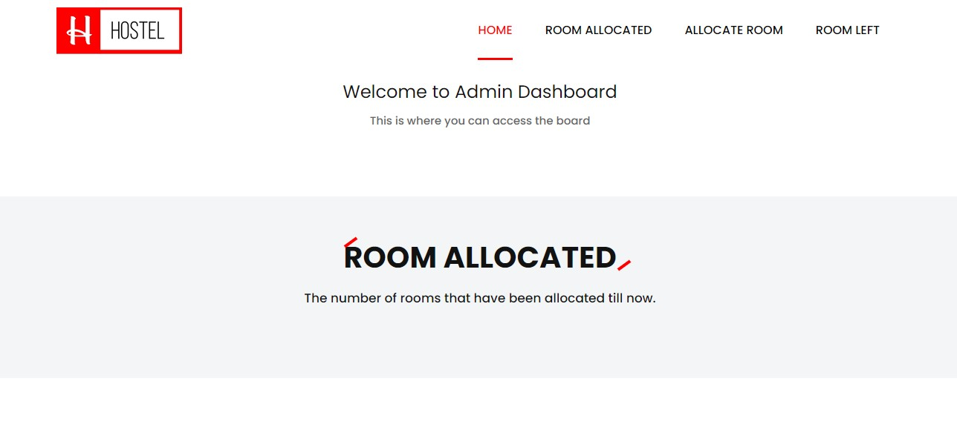
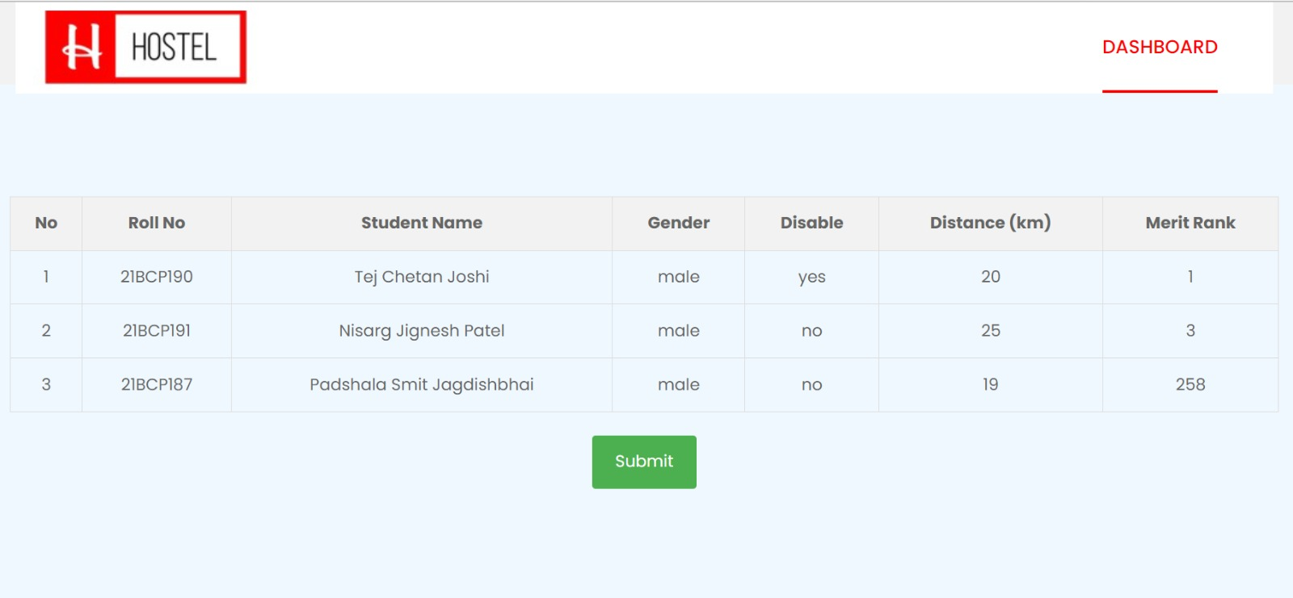
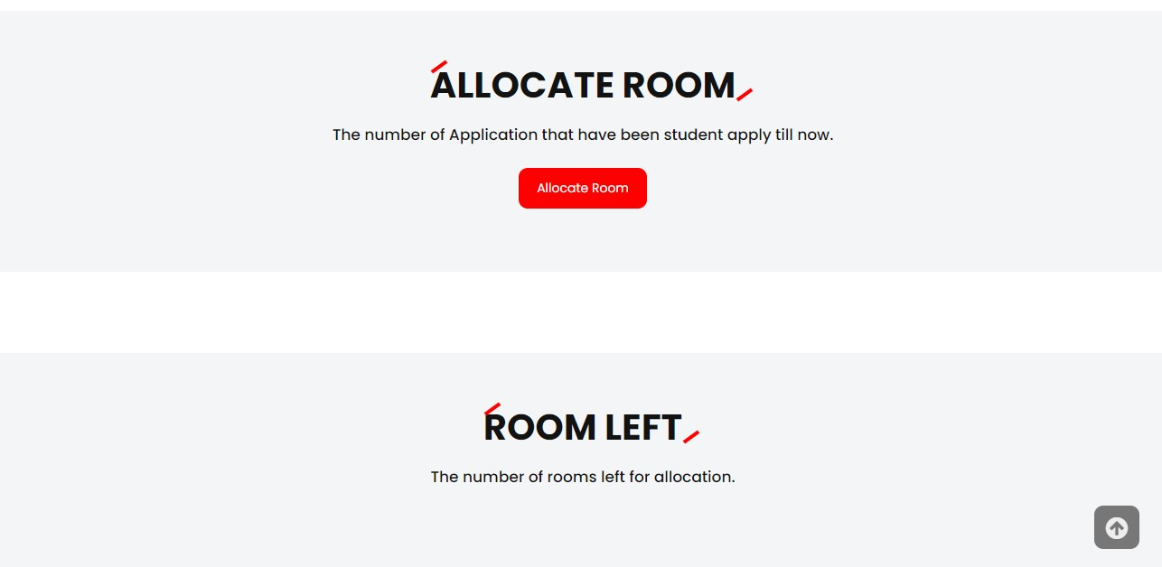
Admin Dashboard

Slide 10
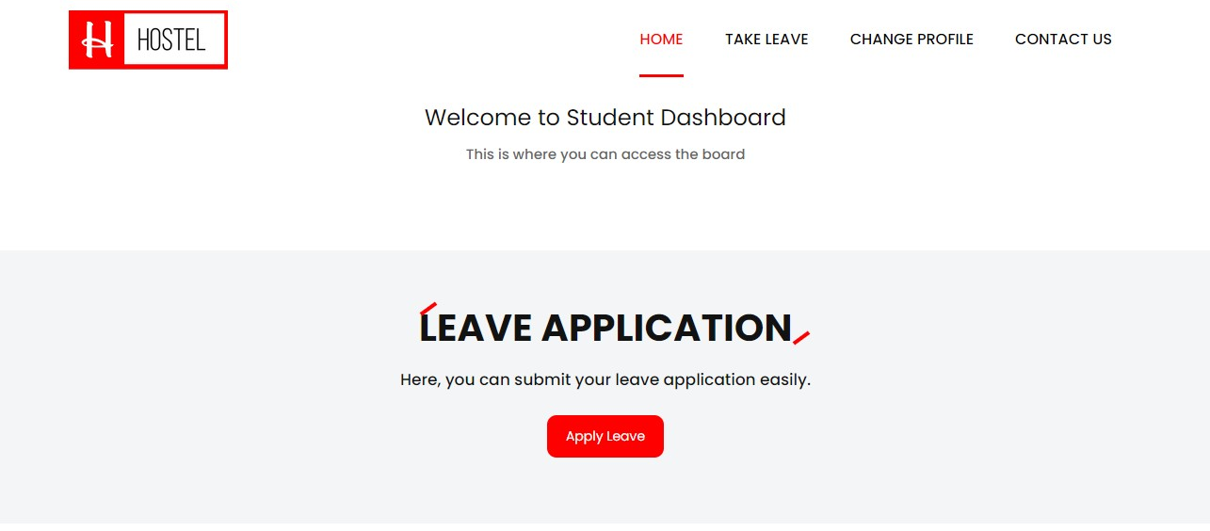
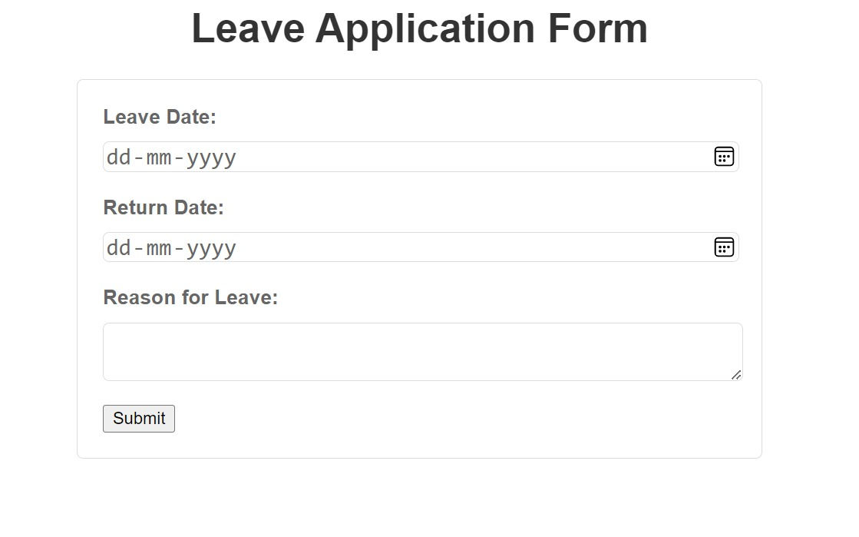
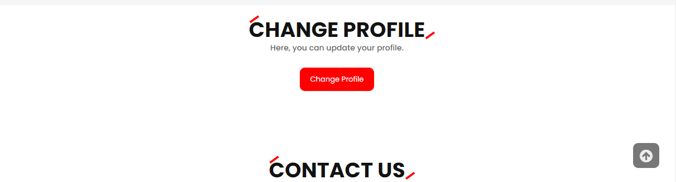
Student Dashboard

Slide 11
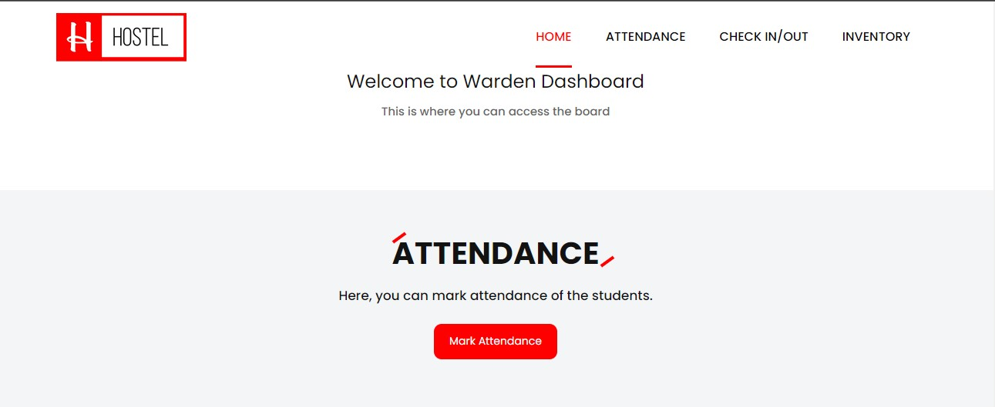
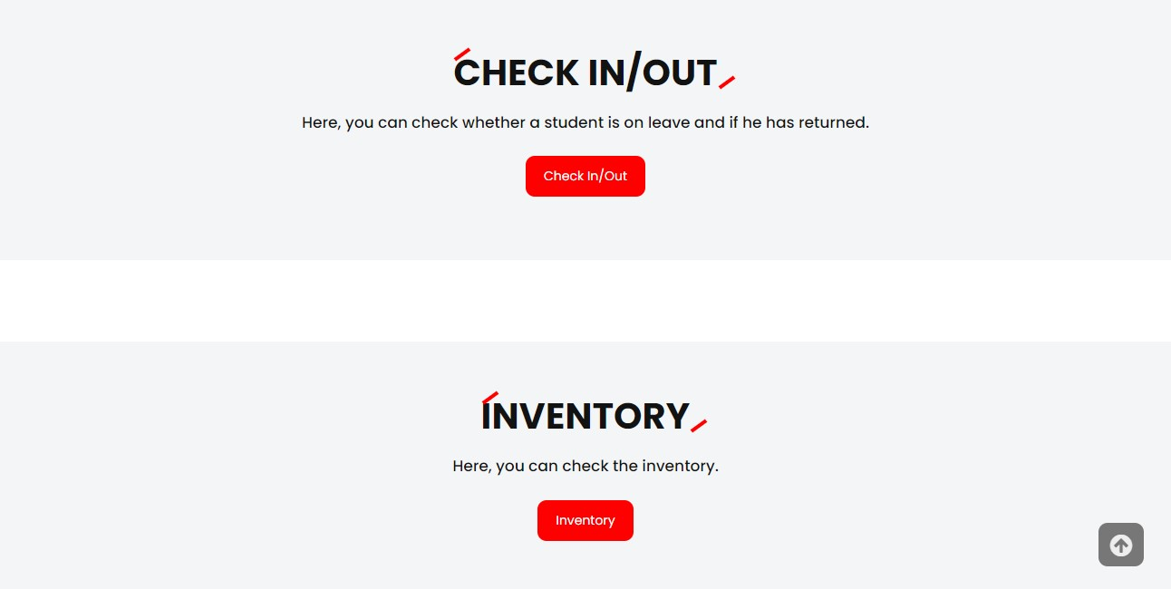
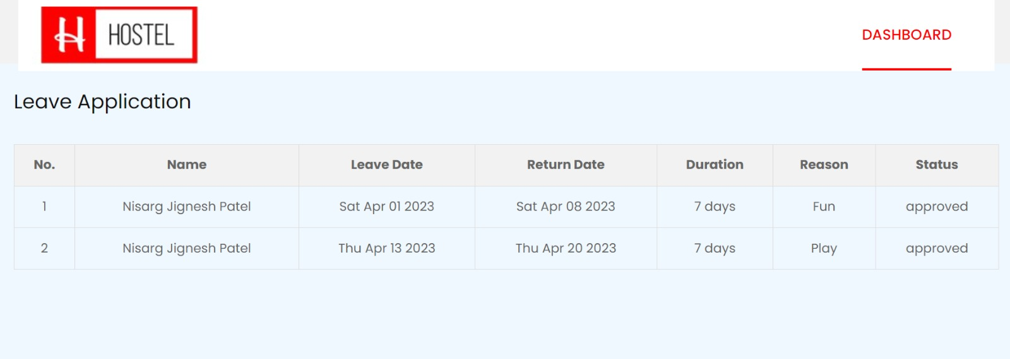
Warden Dashboard

Slide 12
Hardware and Software Used
Hardware used:
Processor: 1.30GHz
Ram: 4GB
Hard disk: 512GB
Software used:
Visual Studio Code, MySQL
Operating System: Windows 10/11
Language : HTML, CSS, JavaScript, NodeJS, SQL

Slide 13
Limitation of Project
Some limitations of the project are:
Multiusers are not supported.
It is not able to generate pdf reports of the students.
Not able to automize the attendance marking of students

Slide 14
Future of the project
There are many additional features, which can be planned to be incorporated during the future enhancement of this project. The future version of this project can handle the accounting of the hostel. Some improvements will mean that we can use this project in real time.
We can make the database centralized by which multiusers can work on the system.
PDF, CSV reporting will be integrated for more reliability.
Voice or face confirmation can be used for marking the attendance of the students.

Slide 15
Thank you!!!

